Slide 1


UniGuide – A Tuition for Collegian
First Year Project Synopsis
Submitted by
Group: Y1-2024-25-G189
ROLL | NAME
2401350016 | Adit Ghosh
2401350018 | Subhrajeet Dash
2401350007 | Harsh Panchal
2401350014 | Manju
Industry Mentor: Ms. Shayani Sharma
Faculty Mentor: Dr. Surabhi Shanker
Y1-2024-25-G189
ENSI152

Slide 2

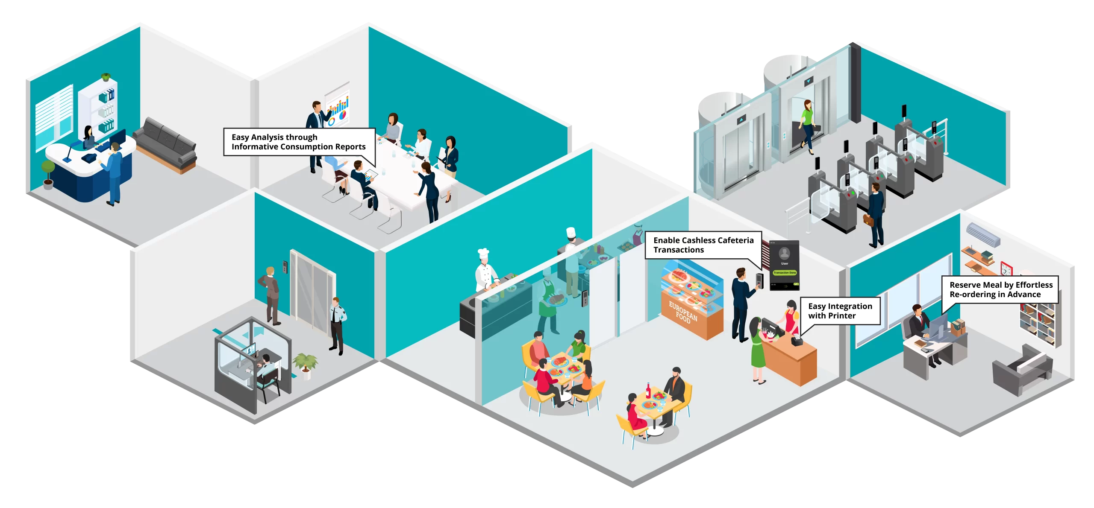
Project overview
This project improves the resource pooling and management of study materials for collegians
It uses features like Web Scraping, PDF reading and filtering, Progress Tracking, Field Specific Roadmaps, Project Suggestion, and Suggestion Box
Y1-2024-25-G189
ENSI152

Slide 3

About the problem
College students struggle to find reliable, structured learning resources, as useful materials are spread across various platforms.
Without a clear roadmap, students face difficulties in organizing their study materials and following an efficient learning path.
The process of compiling quality resources from different online sources is time-consuming and overwhelming for students.
With unorganized resources and no guidance, students may miss important concepts or fail to optimize their study sessions.
Y1-2024-25-G189
ENSI152

Slide 4

Problem Statement
College students struggle to find organized, reliable learning resources online. Information is scattered across platforms, making it difficult to follow a clear, structured learning path, hindering efficient academic progress.
College students struggle to find reliable resources.
Online educational content is scattered and unorganized.
Lack of structured learning paths for courses.
Students face difficulty navigating multiple learning platforms.
Inconsistent quality of resources hinders learning progress.
Y1-2024-25-G189
ENSI152

Slide 5

Problem Statement
Students waste time searching for relevant materials.
Limited personalized recommendations for individual learning needs.
Difficulty tracking academic progress and achievements.
Many resources lack course-specific relevance and clarity.
Current platforms don't offer comprehensive learning roadmaps.
Y1-2024-25-G189
ENSI152

Slide 6

Objectives
Curate High-Quality Resources: Aggregate and organize reliable, relevant educational materials from diverse online platforms to provide a centralized resource library for students.
Design Structured Roadmaps: Develop course-specific roadmaps to guide students through their academic journey, ensuring efficient and targeted learning for each subject.
Personalized Learning Experience: Implement features like progress tracking and personalized recommendations to tailor content and study paths according to individual student needs.
Enhance User Engagement: Create an interactive platform with features like feedback suggestions, enabling continuous improvement based on user input to better meet students' academic requirements.
Y1-2024-25-G189
ENSI152

Slide 7
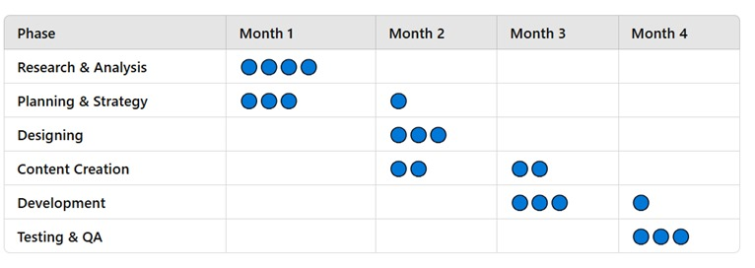
Project Timeline
Breakdown
Month 1 (Mid-January to February): Research, analysis, and initial planning
Month 2 (February to March): Finalize strategy, Data Collection, start designing, and begin content creation
Month 3 (March to April): Complete Creation, testing and debugging, and Shadow Deployment
Month 4 (April – ): Deployment, User reviews and Updating product
Y1-2024-25-G189
ENSI152

Slide 8
Methodology, Tools, and Techniques
• Iterative Development: Continuous updates and feature enhancements.
• User-Centric Design: Prioritizing user experience and feedback.
• Modular Development: Breaking the project into small, manageable modules.
Category | Tools | Techniques
Frontend | HTML, CSS, JavaScript React.js | For building a dynamic interface
Backend | Node.js, Django | Lightweight server framework to handle request,routes & API
Database | NoSQL(MongoDB)/SQL (MySQL) | For handling complex, dynamic data
UI/UX & Design | Figma, BootStrap | For designing UI/UX webiste
API Development & Integration | RESTful API | Webservice that allows different components (frontend, backend and third party services)to communicate efficiently
Y1-2024-25-G189
ENSI152

Slide 9
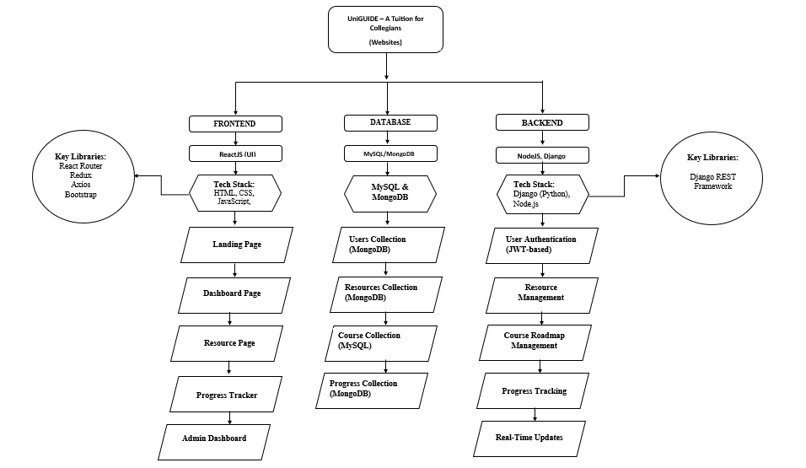
Flowchart
Y1-2024-25-G189
ENSI152

Slide 10
Expected Results & Impact
Features | Expected Outcome | Impact
Web Scraping | The web scraping feature will automatically gather updated, relevant resources, providing students with efficient, personalized learning materials tailored to courses. | Web scraping saves time by automating resource gathering.
PDF reading and filtering | The PDF reading and filtering feature will enable students to quickly access relevant content, saving time and enhancing the learning experience. | With easy-to-navigate resources and efficient filtering, students will experience less stress in finding and processing course material.
Progress Tracking | Students will track their learning progress, ensuring consistent study habits and goal achievement. | Enhances motivation and improves time management
Field Specific Roadmaps | Students will follow a clear, structured path, improving learning efficiency and mastery of course concepts. | Enhanced student engagement and personalized learning experiences tailored to specific fields.
Project Suggestion | Students receive relevant project suggestions that align with their learning goals and interests. | Enhances practical learning and boosts creativity
Suggestion Box | Users can submit feedback to improve resource recommendations and roadmaps for better learning experiences. | Enhances user engagement, ensuring continuous platform improvement based on student needs and preferences.
Y1-2024-25-G189
ENSI152

Slide 11
Challenges and Limitation
Restricted field experience due to the absence of practical, hands-on learning components.
Copyright eligibility limiting access to some valuable educational resources.
Overall lack of knowledge in certain specialized and niche academic courses.
Future Prospects
Allow users to contribute to and refine educational resources.
Foster a collaborative learning environment where students and educators share insights and study materials.
Develop advanced features such as interactive tutorials, user-generated course roadmaps, and industry-specific knowledge-sharing forums.
Enable global participation, creating a rich and diverse repository of study materials tailored to various academic disciplines.
Y1-2024-25-G189
ENSI152

Slide 12

References
https://www.tandfonline.com/doi/abs/10.1080/15391523.2020.1728447
https://www.researchgate.net/publication/229051785_Learning_roadmap_studio_new_approaches_and_strategies_for_efficient_learning_and_training_processes
https://www.cardiff.ac.uk/__data/assets/pdf_file/0007/1409452/Best-Practice-in-Online-Content-Curation.pdf
https://www.researchgate.net/publication/334085214_Approaches_for_Curation_of_Open_Educational_Resources
https://pmc.ncbi.nlm.nih.gov/articles/PMC11235115/
Y1-2024-25-G189
ENSI152

Slide 13
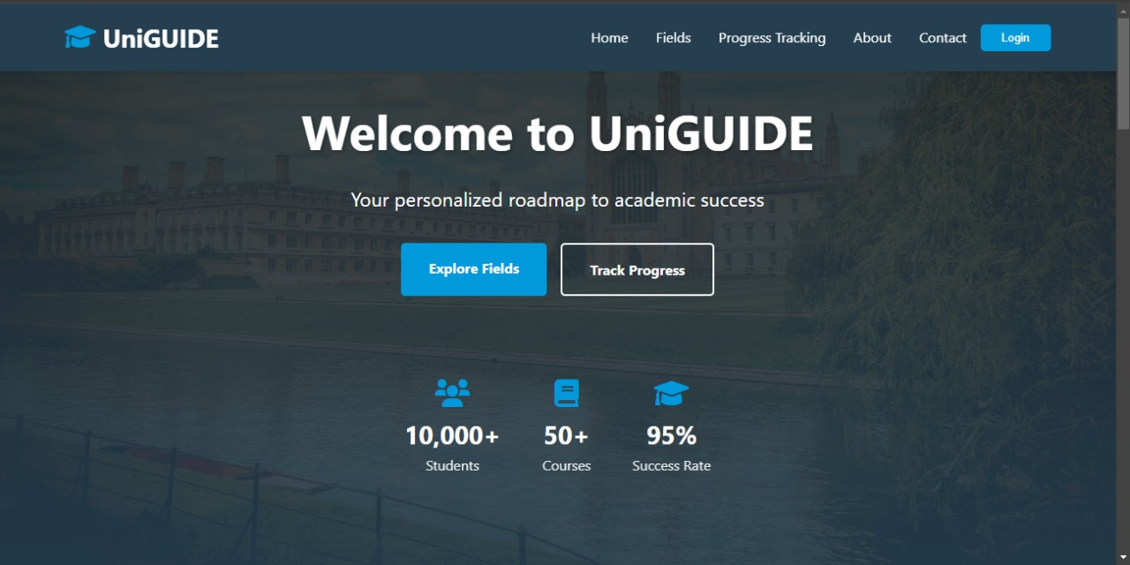
UI Design

Slide 14
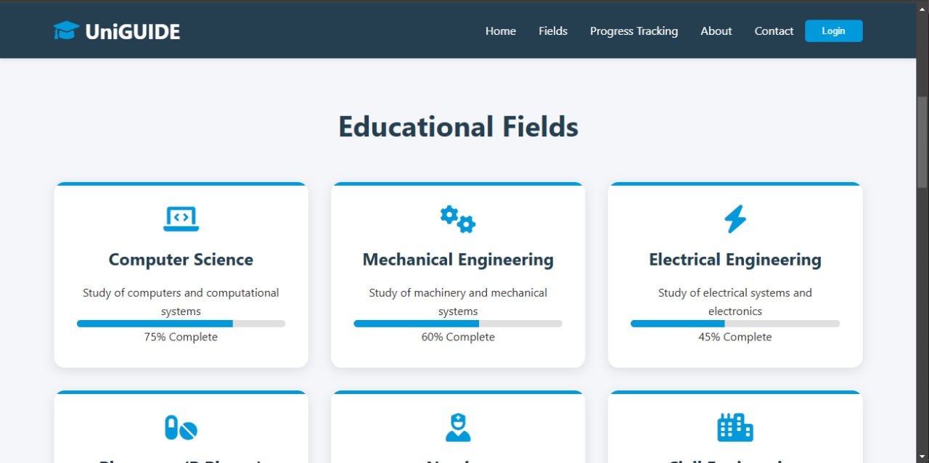

Slide 15
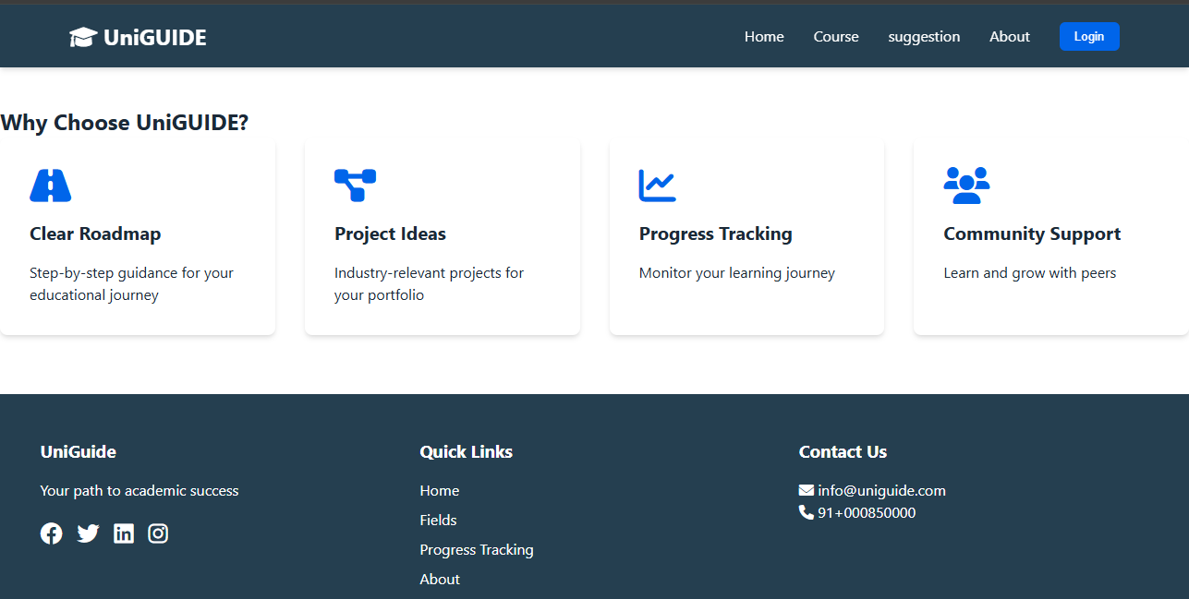

Slide 16


